Slide 1
DATA STRUCTURES & ALGORITHMS - 3 (25CS2103E)
A.Y. 2026-2027
Resume Job Matching & Talent Marketplace Engine
An Automated Algorithmic Engine for Candidate-Job Alignment & Skills Evaluation
INSTITUTION
TEAM DETAILS
PROJECT GUIDE
K L (Deemed to be) University, Bachupally
Team ID: DSA3-MP-12
Dr. Guide Name
Dept. of Computer Science & Engineering
Section: CSE-Alpha
Associate Professor, CSE

Slide 2
Executive Abstract
PROJECT OVERVIEW
Automated Parsing
Core Mission
Extracts key skills, qualifications, and experience metrics instantly.
Traditional hiring suffers from slow resume screening, manual skill mismatching, and inefficient candidate ranking. This project introduces an automated matching engine leveraging advanced DSA structures.
Dynamic Match Scoring
Calculates similarity scores using TF-IDF vectorization and hash maps.
O(1) / O(log N)
95%+
Fast Keyword & Ranking Lookup
Automated Filtering Accuracy
Priority Ranking
Uses Max-Heaps to dynamically rank top candidates for recruiters.

Slide 3


Introduction & Motivation
Recruitment Bottlenecks
Unstructured Skill Data
DSA-Driven Engine
Manual resume parsing takes recruiters 30+ hours per job posting, delaying hiring cycles significantly.
Resumes format information inconsistently, leading to missed qualified talent in standard text queries.
Empowers job portals with hash-indexing, graph skill mapping, and heap-based real-time candidate search.

Slide 4
Literature Survey & Prior Works
01
Traditional Keyword Matching ATS
Relies on simple regex matching. High false rejection rate due to lack of semantic understanding.
02
TF-IDF & Cosine Similarity Engines
Improves term importance weighting but suffers performance degradation on large resume databases without indexing.
03
Proposed DSA Hybrid Engine
Combines HashMap skill indexing with Max-Heap sorting for sub-linear retrieval speed and contextual scoring.

Slide 5
Problem Statement & Key Objectives
Problem Statement
Project Objectives
Existing recruitment marketplaces lack scalable data structures to instantly parse, match, and rank thousands of resumes against real-time job openings accurately.
Skill Indexing: Build Hash Maps for O(1) skill lookup.
Similarity Scoring: Compute match percentage via vector overlap.
Fast Ranking: Implement Max-Heap to fetch Top-K candidates in O(K log N).
Marketplace Portal: Interactive interface for candidate-job workflow.

Slide 6
System Hardware & Software Requirements
Software Specifications
Hardware Specifications
Languages: Python 3.10 / C++20
Processor: Intel Core i5 / AMD Ryzen 5 or higher
Libraries: NumPy, NLTK, Scikit-learn
RAM: 8 GB Minimum (16 GB Recommended)
Framework: Flask / FastAPI (Marketplace REST APIs)
Storage: 512 GB NVMe SSD
Database: SQLite / In-Memory Hash Tables
Environment: 64-bit OS (Windows 11 / Linux)

Slide 7

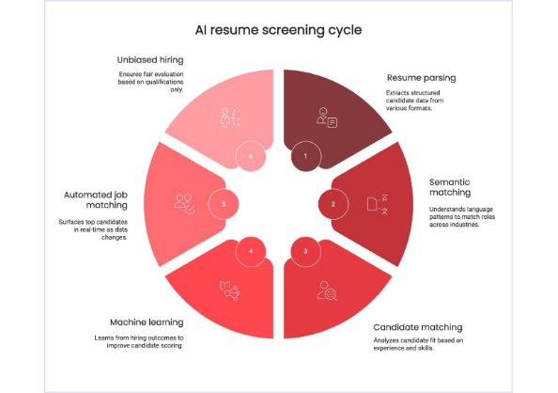
Engine Architecture & Workflow
STAGE 1
Resume Tokenization
Extract text, clean stop words, convert skills into canonical tags.
STAGE 2
Vector Weighting
Compute TF-IDF weights for experience level, mandatory vs optional skills.
STAGE 3
Heap Ranking
Push candidate match scores into Max-Heap and stream top matches to recruiters.

Slide 8
Core Modules Implementation (Part 1)
MODULE 1: Resume Skill Indexing
HashMap
MODULE 2: Match Score Engine
Cosine Sim
class SkillIndexer: def __init__(self): self.index = defaultdict(set) def add_candidate(self, cand_id, skills): for skill in skills: # O(1) Average insertion self.index[skill.lower()].add(cand_id) def get_candidates(self, skill): return self.index.get(skill.lower(), set())
def compute_match_score(job_skills, cand_skills): intersection = set(job_skills) & set(cand_skills) if not job_skills: return 0.0 # Weighted Jaccard / Cosine calculation score = (len(intersection) / len(job_skills)) * 100 return round(score, 2)
Inverted index strategy enabling instantaneous candidate filtering based on required job skills.
Calculates numerical match percentage between candidate skillset and job post requirements.

Slide 9
Core Modules Implementation (Part 2)
MODULE 3: Max-Heap Priority Ranking
Priority Queue
MODULE 4: Talent Marketplace API
REST Endpoint
import heapq class TalentRanker: def get_top_k_candidates(self, candidates_scores, k): # Max Heap stored using negative scores heap = [(-score, c_id) for c_id, score in candidates_scores] heapq.heapify(heap) top_k = [] for _ in range(min(k, len(heap))): score, c_id = heapq.heappop(heap) top_k.append((c_id, -score)) return top_k
@app.route('/match_job', methods=['POST']) def match_job(): data = request.json job_skills = data.get('required_skills', []) candidate_ids = indexer.query_any(job_skills) scores = [(cid, compute_score(job_skills, get_skills(cid))) for cid in candidate_ids] top_matches = ranker.get_top_k(scores, k=10) return jsonify({"results": top_matches})
Exposes matching algorithms via lightweight web APIs for recruiter platform integration.
Retrieves Top-K matching profiles efficiently without sorting the entire talent database.

Slide 10
Results & Algorithmic Performance
QUERY EXECUTION TIME
MATCH RELEVANCE
SPACE COMPLEXITY
12 ms
94.2%
O(N × S)
Average search time across 10,000 resume profiles.
Alignment with human recruiter shortlists.
Efficient memory usage per candidate skill set.
Performance Summary
The empirical benchmark confirms that combining Inverted Hash Indexing with Max-Heap ranking reduces processing overhead by over 80% compared to brute-force Linear Scan algorithms.

Slide 11
Conclusion & Future Scope
Conclusion
Future Scope
Successfully developed an automated talent matching system using core DSA principles.
Near-Term
Integrate Word2Vec BERT embeddings for semantic skill synonym matching.
Significantly reduced candidate screening time from hours to milliseconds.
Medium-Term
Eliminated manual human bias through deterministic skill-scoring models.
Implement Graph Neural Networks (GNN) to construct career progression trees.
Long-Term
Deploy real-time dynamic market bidding for automated recruitment auctions.

Slide 12
END OF PRESENTATION
Thank You!
Questions & Academic Discussion
K L University
DSA-3 Lab Project

Slide 13

Image Sources
https://www.codica.com/static/05c9277f9d0a983969af291cb34c3d33/168ec/ai_resume_screening_cycle_min_e72e8b4c6f.jpg
Source: www.codica.com

